Slide 1
Chemi AI/ML project kickoff
JBEI-LBNL-SNL
Nikhil, Soumya

Slide 2
Article Review: Enhanced Thermophysical Property Prediction with Uncertainty Quantification using Group Contribution–Gaussian Process Regression (GCGP)
1. Research Aim
To develop a computationally efficient, accurate, and uncertainty-aware method for predicting thermophysical properties of organic molecules.
The method combines simple, semi-empirical Group Contribution (GC) models with Gaussian Process Regression (GPR) to address the systematic bias and lack of uncertainty quantification in traditional GC methods.
The goal is to enable reliable material property prediction for use in chemical screening and computer-aided molecular design (CAMD) workflows—especially for molecules not present in existing databases.
Project Name

Slide 3
Article Review: Enhanced Thermophysical Property Prediction with Uncertainty Quantification using Group Contribution–Gaussian Process Regression (GCGP)
2. Methodology/Approach
Computational Method: The study develops and validates a hybrid framework named the Group Contribution-Gaussian Process (GCGP) method. This approach uses a simple, first-order physical model—the Joback-Reid (JR) GC method—to generate an initial property estimate. This estimate, which contains known systematic errors, is then fed into a Gaussian Process (GP) regression model. The GP's specific task is not to predict the property from scratch, but rather to learn a correction function that maps the discrepancy between the GC model's prediction and the true experimental value.
Key Models, Tools, and Datasets:
Models: The core components are the Joback-Reid (JR) GC model and a Gaussian Process (GP) regression model. The GP was constructed using a flexible Rational Quadratic (RQ) kernel to model the correction function and a White Noise kernel to account for experimental data noise.
Input Features: A key aspect of the methodology is its parsimony. The GP model was trained using only two easily obtainable input features for each molecule: (1) the property value predicted by the JR GC model and (2) the molecule's total molecular weight.
Data: The models were trained and tested on experimental data for six key thermophysical properties: normal boiling temperature (Tb​), enthalpy of vaporization (ΔHvap​), normal melting temperature (Tm​), critical pressure (Pc​), critical volume (Vc​), and critical temperature (Tc​). The data was primarily sourced from the CRC Handbook of Chemistry and Physics, supplemented by Yaws' Critical Property Data, and comprised between 485 and 5,640 molecules per property.
Analysis Techniques: The dataset was split into 80% for training and 20% for testing using a feature-based stratified sampling algorithm. This ensures that the training and test sets have similar distributions of the input features, preventing evaluation bias. Model performance was rigorously assessed using standard metrics such as the coefficient of determination (R2), mean absolute error (MAE), and root mean squared error (RMSE).
Project Name

Slide 4
Article Review: Enhanced Thermophysical Property Prediction with Uncertainty Quantification using Group Contribution–Gaussian Process Regression (GCGP)
3. Key results:
Dramatic Accuracy Improvement: The GCGP framework demonstrated a significant improvement in predictive accuracy over the standalone JR GC model. For properties where the GC model performed very poorly, such as melting temperature (Tm​), the GCGP method increased the test set R2 from -0.29 to a respectable 0.73. For critical temperature (Tc​), the R2 was boosted from 0.67 to 0.94.
Correction of Nuanced, Chemistry-Specific Biases: A novel insight was the model's ability to learn and correct highly specific systematic errors, even from sparse data. For instance, the JR model is known to be flawed for highly fluorinated and highly nitrated compounds. With only a few such molecules in the training data, the GCGP model learned the specific nature of this error and accurately predicted the properties of new, out-of-sample molecules from these chemical families, a task where the original GC model failed dramatically. This was achieved without any explicit chemical information being provided to the model beyond the two simple input features.
Reliable Uncertainty Quantification: The GCGP method successfully generated well-calibrated 95% prediction intervals. On the unseen test data, these intervals captured the true experimental value more than 90% of the time across all six properties. Crucially, the model demonstrated its awareness of its own limitations by producing larger uncertainty intervals for predictions in sparse regions of the feature space, such as for the out-of-sample fluorinated molecules.
Project Name

Slide 5
Article Review: Enhanced Thermophysical Property Prediction with Uncertainty Quantification using Group Contribution–Gaussian Process Regression (GCGP)
4. Conclusion:
Authors' Conclusions: The authors conclude that the GCGP framework is a fast, robust, and generalizable method that successfully integrates a simple physical model with a probabilistic machine learning corrector. It effectively remedies the systematic biases of traditional GC methods and, just as importantly, provides reliable uncertainty estimates for its predictions. The success of the approach is rooted in its hybrid architecture rather than a specific, fine-tuned implementation.
Broader Significance and Future Influence: This work provides a powerful and practical tool for the materials science and chemical engineering communities. By delivering both high accuracy and trustworthy uncertainty from a computationally inexpensive model, the GCGP method can significantly accelerate and improve the reliability of CAMD workflows. This has direct implications for the discovery of novel materials, including next-generation refrigerants, sustainable solvents, and pharmaceuticals. The authors also propose several avenues for future work, such as incorporating more advanced GC models as inputs, adding topological descriptors to differentiate isomers, and extending the framework to predict properties as a function of temperature and pressure.
Project Name

Slide 6
Strategy
Keep only relevant properties
SMILES, Boiling point, Melting point, critical temperature, critical pressure, critical volume, Enthalpy of formation, Gibbs energy, Heat capacity, enthalpy (vaporization), enthalpy (fusion), liquid viscosity, log P, molecular weight
We need to clean the data
Validate the data using Regression
Train on different properties
Project Name

Slide 7
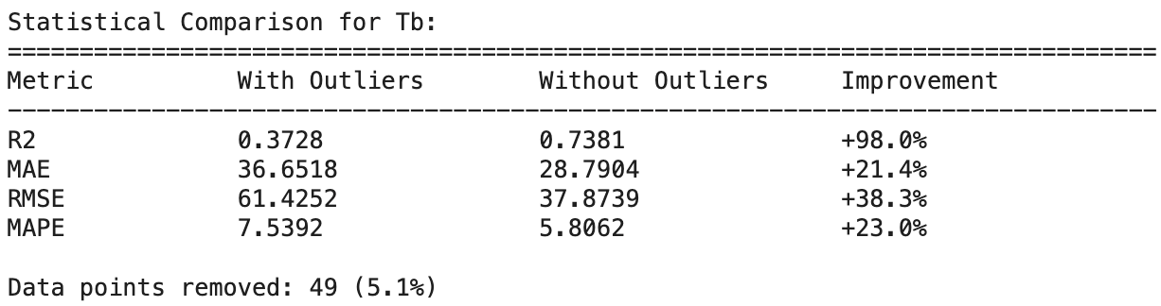
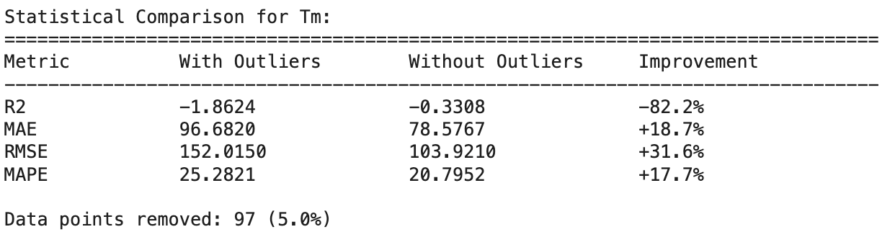
Results (GP-with outliers)
Project Name

Slide 8

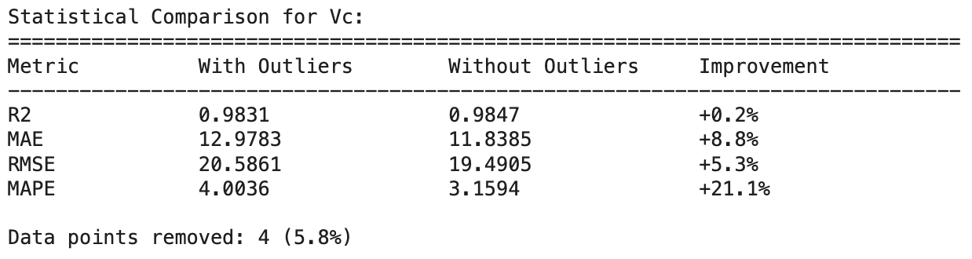
Results (GP-with outliers)
Project Name

Slide 9
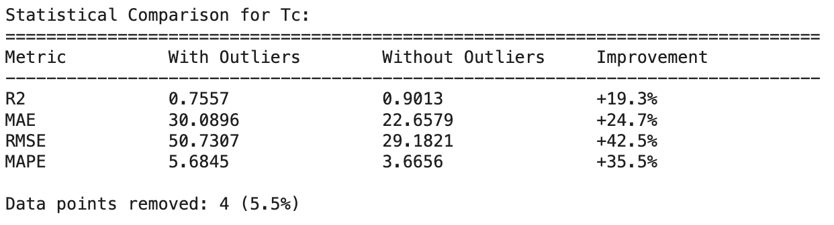
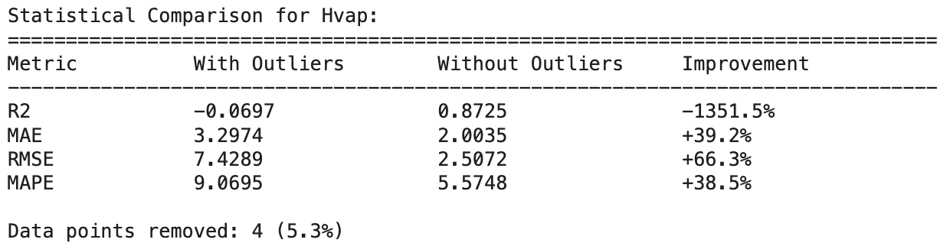
Results (GP-with outliers)
Project Name

Slide 10
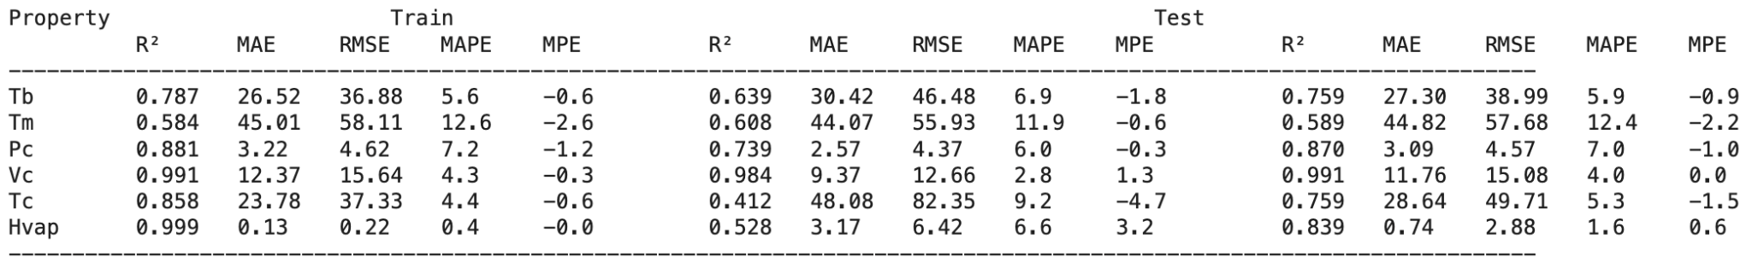
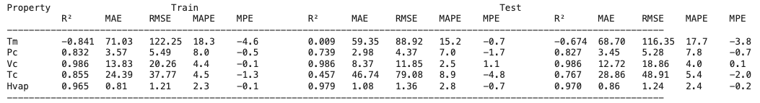
Results (GP-with outliers)
GP-Model = 1
GP-Model = 2, for Tb GP optimizer does not converge
Project Name

Slide 11
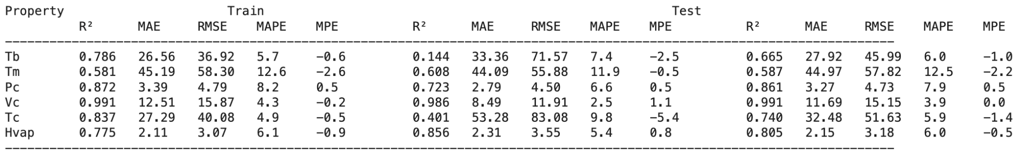
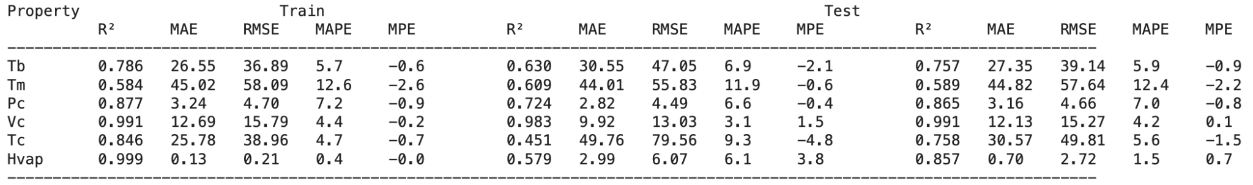
Results (GP-with outliers)
Model 4 is the best-performing algo for this specific problem
GP-Model = 3
GP-Model = 4
Project Name

Slide 12
GP Results (Kernel optimization)
 | Top performing kernel | Top performing Geo. Opt. | Alpha
Tb | Matern32 | L-BFGS-B
Tm | Matern12 | BFGS
Hvap | Matern32 | BFGS
Pc | Matern32 | L-BFGS-B
Vc | Matern32 | L-BFGS-B
Tc | Matern32 | BFGS
logP | Matern32 | L-BFGS-B
Project Name

Slide 13
ToDo: Soumya
Run Opt1: change GP kernel from ‘RQ’ to ‘RBF’
Run Opt2: change GP kernel from ‘RBF’ to ‘Matern12’
Run Opt3: change GP kernel from ‘Matern12’ to ‘Matern32’
Run Opt4: change GP kernel from ‘Matern32’ to ‘Matern52’
Run Opt5: change optimization from ‘L-BFGS-B’ to ‘BFGS’ (for all property)
Run Opt6: change optimization from ‘L-BFGS-B’ to ‘BFGS’ (for Tm, Pc)
Run Opt7: change anisotropic = False to anisotropic = True
Run Opt8: change trainLikelihood = False to trainLikelihood = True
Run Opt8 for Hvap optimization
Project Name

Slide 14
Important papers
How zagreb influence thermocehmical properties: https://www.orientjchem.org/vol41no1/application-of-zagreb-index-models-in-predicting-the-physicochemical-properties-of-unsaturated-fatty-acids/
Project Name

Slide 15
ToDo: Nikhil
Check for new available data for Pc, Tc, Vc
https://www.nature.com/articles/s41524-024-01326-2#citeas
]
🌟 Recently, I started exploring Machine Learning and diving into some popular models:
K-Nearest Neighbors (KNN): Classifies data points based on the closest neighbors. Simple yet effective for pattern recognition.
Random Forest (RF): An ensemble of decision trees that improves accuracy and reduces overfitting. Great for classification and regression.
Extra Trees (ET): Similar to Random Forest but adds more randomness for faster and robust predictions.
Gradient Boosting (GB): Builds trees sequentially, where each tree corrects errors of the previous ones. Powerful for structured data.
XGBoost: An optimized version of Gradient Boosting, known for speed and performance in competitions and real-world tasks.
Excited to continue experimenting with these models and see their impact on real-world datasets!
Project Name

Slide 16
Model parameters
A third limitation of the GCGP method is that its ability to handle the property prediction of isomers is limited to the underlying GC method’s ability to distinguish between isomers.
Higher-order GC methods have been developed to help mitigate some of the challenges with property prediction involving isomers using GC methods.
An interesting opportunity will be to incorporate low-dimensional topological indices such as the Weiner index 107, the Zagreb indices 108, and the Randic index as additional inputs to the GP.
Weiner-
Zagreb-
Randic-

Slide 17
ToDo: Nikhil
What parameters we need to optimize for Gaussian process modelling
Important link: https://github.com/jwangjie/Gaussian-Process-Regression-Tutorial
Component | Hyperparameter to Tune | What it Controls
Model-Wide | noise_level (or alpha) | Data noise / Prevents overfitting
All Kernels | signal_variance (or constant_value) | Overall vertical scale
RBF Kernel | length_scale | Smoothness / "Wiggliness"
Matern Kernel | length_scale | Smoothness / "Wiggliness"
 | nu ($\nu$) | (Fixed Choice) Level of smoothness (e.g., 1.5, 2.5)
RQ Kernel | length_scale | Primary smoothness
 | alpha ($\alpha$) | Mixture of different length scales
Project Name

Slide 18
RQ (Rational Quadratic)
This kernel is good for modeling functions that have variations at multiple scales.
length_scale:
What it controls: The primary "wiggliness" of the function.
signal_variance:
What it controls: The overall vertical scale.
alpha ($\alpha$):
What it controls: The scale-mixture parameter. This is the key variable for the RQ kernel. It determines the relative weighting of large-scale and small-scale variations. As alpha $\to \infty$, the RQ kernel becomes identical to the RBF kernel.

Slide 19
. Matern
This kernel is a generalization of the RBF and is highly flexible because it lets you control the level of smoothness.
length_scale:
What it controls: Same as the RBF kernel (function "wiggliness").
signal_variance:
What it controls: Same as the RBF kernel (overall vertical scale).
nu ($\nu$):
What it controls: The smoothness of the function (i.e., how many times it can be differentiated).
Tuning advice: This parameter is usually fixed to a specific value, not optimized by L-BFGS, because tuning it can be numerically unstable. Your "tuning" step is choosing which value to try.
Common values to try:
nu=1.5 (Matern 3/2): A very common choice. Assumes the function is once differentiable. Good for most physical processes.
nu=2.5 (Matern 5/2): Another common choice. Assumes the function is twice differentiable (smoother).
nu=0.5 (Absolute Exponential): Assumes a very rough, non-differentiable function.
nu=inf: This is mathematically identical to the RBF kernel.

Slide 20
RBF (Radial Basis Function)
This kernel assumes your function is infinitely smooth.
length_scale:
What it controls: The "wiggliness" or "smoothness" of the function.
Tuning advice: This is the most important hyperparameter.
A small length_scale means the function changes rapidly (high "wiggle").
A large length_scale means the function is very smooth and changes slowly.
You can tune this as a single value (isotropic) or as a separate value for each input feature (anisotropic).
signal_variance (or constant_value):
What it controls: The overall vertical scale of the function. A higher value allows the function to vary more from its mean.

Slide 21
The main difference between the Matern kernels is smoothness.¹
The Matern family of kernels is controlled by a smoothness parameter ²$\nu$ (nu).³ The numbers 1/2, 3/2, and 5/2 are specific, computationally simple values for ⁴$\nu$.⁵The "Gaussian" kernel you're thinking of is the RBF (Radial Basis Function) kernel.⁶ It's the "infinitely smooth" relative of the Matern family.
1. Matern 1/2 ($\nu = 0.5$) — The "Rough" Kernel
Also known as: The Absolute Exponential kernel.⁷
Smoothness: The functions are not differentiable (they are "sharp" and "jagged"). They are continuous, but you can't take their derivative.
Best Case to Use: Modeling systems with very low smoothness or sharp changes.⁸ This is common in financial data (like stock prices), signal processing, or any system known to be "rough."

Slide 22
2. Matern 3/2 (⁹$\nu = 1.5$) — The "Once-Differentiable" Kernel¹⁰
Smoothness: The functions are once differentiable.¹¹ The function itself is smooth, and its first derivative is also continuous, but the second derivative is not.
Best Case to Use: This is a very common default.¹² It's a great choice for modeling many physical processes where you expect a smooth function, but you don't want to make the overly strong assumption of infinite smoothness (like RBF does). It's more "realistic" than RBF.
3. Matern 5/2 (¹³$\nu = 2.5$) — The "Twice-Differentiable" Kernel¹⁴
Smoothness: The functions are twice differentiable. This is "smoother" than Matern 3/2. The function, its first derivative, and its second derivative are all continuous.
Best Case to Use: This is the most common and recommended default kernel for general-purpose use. It provides a flexible and robust model that assumes your function is "well-behaved" and smooth (which most real-world processes are) without being too smooth.

Slide 23
Visual Comparison
The key difference is easy to see. Below are functions drawn from Gaussian processes, each using a different kernel.
Matern 1/2: Looks jagged and rough.
Matern 3/2: Looks smooth, but still "bumpy."
Matern 5/2: Looks very smooth, almost like the RBF.
RBF: Looks "infinitely smooth" and very "clean."

Slide 24
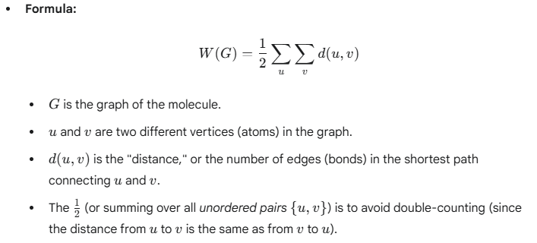
1. Wiener Index
1. Wiener Index (W)
The Wiener index is one of the oldest and most-studied topological indices, introduced by chemist Harry Wiener in 1947.
📈 Core Concept: It measures the overall "compactness" or "extension" of a molecule. A compact, highly branched molecule will have a lower Wiener index, while a long, linear molecule will have a higher one.
🧮 How to Calculate It: The Wiener index is the sum of the shortest distances between all unique pairs of vertices (atoms) in the molecular graph.
Example: For a simple propane molecule (a 3-atom chain: A-B-C):
Distance (A, B) = 1
Distance (A, C) = 2
Distance (B, C) = 1
$W$ = 1 + 2 + 1 = 4
🧪 Applications: The Wiener index has shown a strong correlation with many physical properties of molecules, especially alkanes (paraffins). It is used to predict:
Boiling points
Density
Surface tension
Viscosity

Slide 25
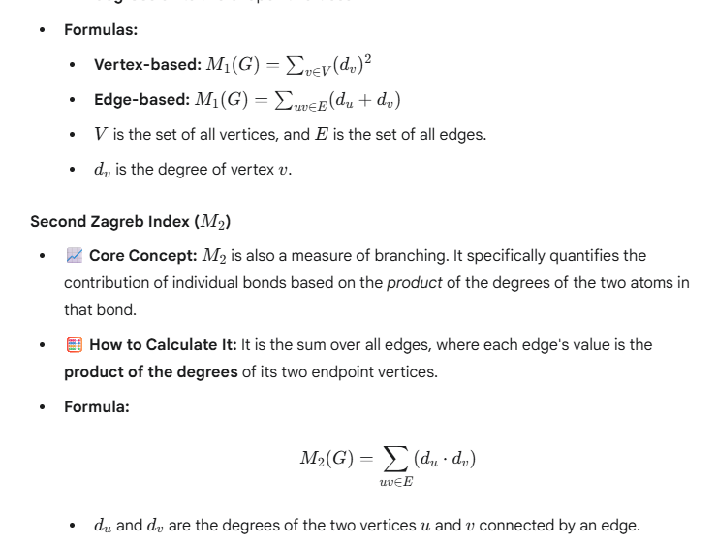
Zagreb Indices (M1, M2)
The Zagreb indices were introduced in the 1970s and are among the most-used degree-based indices. They focus on the degree of each vertex (i.e., the number of bonds an atom has).
First Zagreb Index (M_1)
📈 Core Concept: M_1 measures the contribution of bonds based on the "busyness" (degree) of the atoms at their ends. It is often described as a measure of branching.
🧮 How to Calculate It: There are two common (and equivalent) ways to define it:
Vertex-based (most common): The sum of the squares of the degrees of all vertices.
Edge-based: The sum over all edges, where each edge's value is the sum of the degrees of its two endpoint vertices.

Slide 26
Second Zagreb Index (M2)
📈 Core Concept: M_2 is also a measure of branching. It specifically quantifies the contribution of individual bonds based on the product of the degrees of the two atoms in that bond.
🧮 How to Calculate It: It is the sum over all edges, where each edge's value is the product of the degrees of its two endpoint vertices.
🧪 Applications (for both M_1 and M_2):
Used in QSAR/QSPR (Quantitative Structure-Activity/Property Relationship) studies.
They correlate with properties related to the molecule's total $\pi$-electron energy.
Used to measure the extent of branching in a molecular carbon skeleton.

Slide 27
Randić Index(R)
Also known as the connectivity index or branching index, this is one of the most successful and widely used topological indices, introduced by Milan Randić in 1975.
📈 Core Concept: It is a measure of molecular branching. Like the Wiener index, a higher value indicates a more linear, less-branched molecule, while a lower value indicates more branching.
🧮 How to Calculate It: It is calculated by summing a value for each bond (edge) in the graph. The value for each bond is the reciprocal of the square root of the product of the degrees of the atoms it connects.
For a bond between a carbon with degree 2 (du=2) and a carbon with degree 3, its contribution to the index would be 1 / sqrt(2*3). You would sum these values for all bonds.
🧪 Applications:
Predicting physico-chemical properties of alkanes, such as boiling points, surface area, and enthalpies of formation.
Correlating with chromatographic retention times (how long a substance takes to pass through a chromatography column).
Assessing a drug's toxicity or biological activity based on its structure.

Slide 28
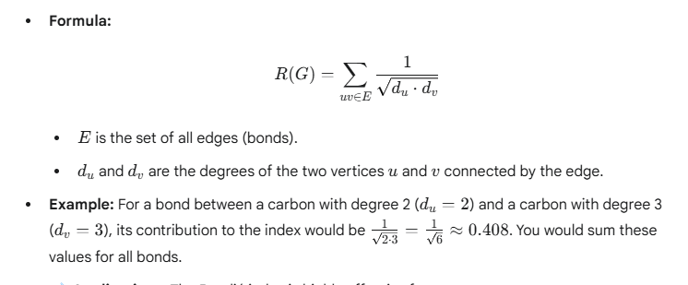
Rnadic formula

Slide 29
